Slide 1


Improving Statistics on Fertility and Mortality in ESCWA Region
Cairo, Egypt
3 – 6 December 2007
Country: Kingdom Of Bahrain

Slide 2

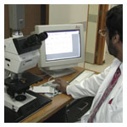
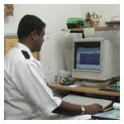
AGENDA
Background: Kingdom of Bahrain
Population Density in Bahrain
Population of Bahrain Health Statistics
CIVIL Population Registration System
Birth & Death Registration
Marriage & Divorce Registration
National Civil Population Registration
Vital Statistics & Reports
Plans To improve the civil Registration and Vital Statistics
Questions

Slide 3



The Kingdom of Bahrain
An overview
Location: Middle East, east of Saudi Arabia
Area: 735.8 sq km
Natural resources: oil, natural gas, fish, pearls
Capital: Manama
Population: 742,562
Ethnic groups: Bahraini 62%, non-Bahraini 38%
Languages: Arabic, English, Persian, Hindi
Literacy: 87.7%

Slide 4
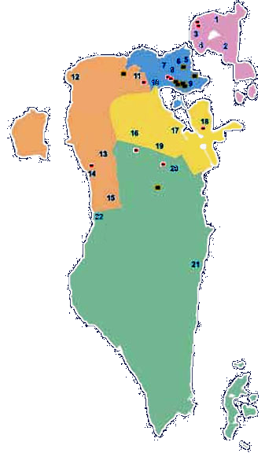
Population Density in Bahrain
Muharraq Governorate
Capital Governorate
Governorate 2006
Muharraq 3254
Capital 5706
Northern 1436
Central 2164
Southern 119
Central Governorate
Northern Governorate
Southern Governorate

Slide 5
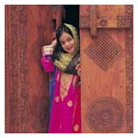
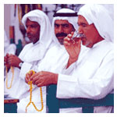
Population of Bahrain
Age Groups Bahraini Non-Bahraini Total
<15 35.8% 13.5% 27.3%
15-64 60.5% 85.9% 70.2%
64> 3.7% 0.6% 2.5%

Slide 6
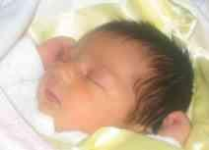
CIVIL Population Registration System
Vital Events & Registration Primary Sources
Vital Events are constituted by data recorded for a person under a system for recording births , marriages , divorce, and deaths .
various Ameri Decrees (legislations) to regulate the registrations of different vital events
Vital events | Agency primarily responsible for registration
Live births | Birth & death registration Office, Ministry of Health
Fetal deaths | Birth & death registration Office, Ministry of Health
Deaths | Birth & death registration Office, Ministry of Health
Marriages | Shariti’a Court – Muslim, High Civil Court – Other Religion
Divorces | Shariti’a Court – Muslim, High Civil Court – Other Religion
CIVIL POPULATION REGISTRAION – Central Informatics Organization

Slide 7
Birth & Death Registration
Minister of Health
Undersecretary
Assistant Undersecretary for Primary Health Care &
Public Health
Others
Public Health Directorate
Birth & Death Registration

Slide 8
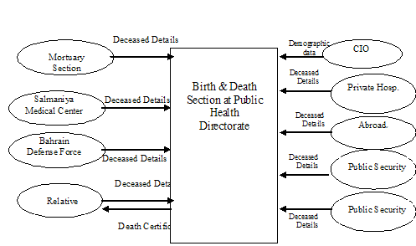
Birth & Death Registration System

Slide 9
Marriage & Divorce Registration
H.M. Court
High Judicial Council
High Civil Court – Other Religion
High Civil Curt – Other Religion
Shariti’a Court – Moslim
Directorate of Registrations & Documentations

Slide 10
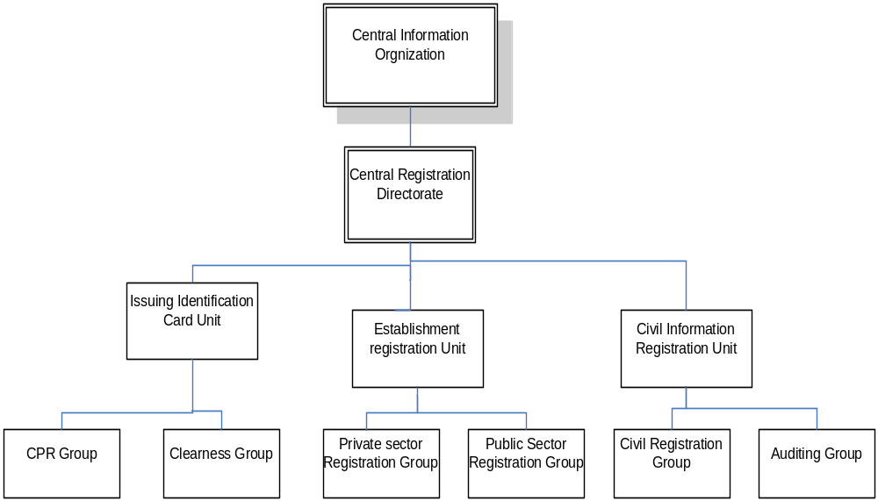
National Civil Population Registration

Slide 11
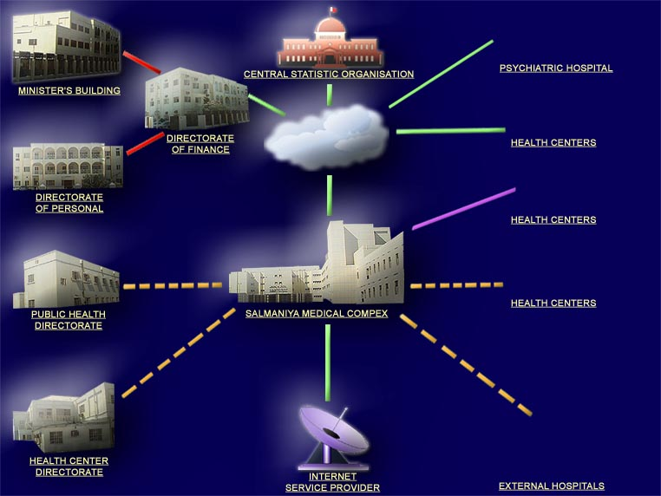
Organization Structure
International Health Organization/ providers

Slide 12

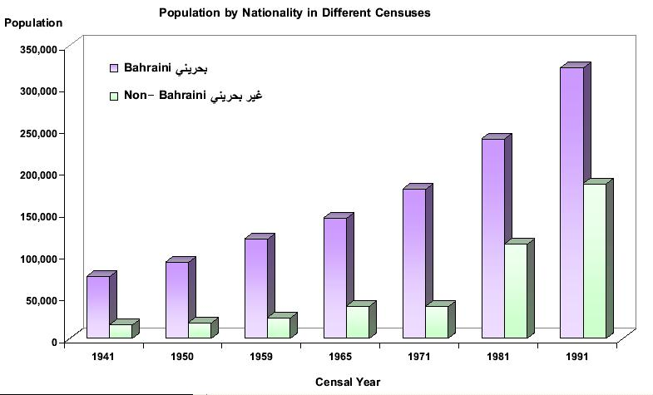
Vital Statistics & Reports
The Vital Statistics reports are essential for administrative purposes both business and government in the kingdom
All the above agencies were obliged to publish annual statistics and dispatched them to public in various publication media.
Examples:
Demographic Data – Census Every 10 years, Last 2001 by Directorate of Statistics – CIO
Vital Statistics – Health Information Directorate Ministry of Health
Bahrain in Abstract by Directorate of Statistics – CIO

Slide 13
Plans To improve the civil Registration and Vital Statistics - 1
Ministry Of Health: (Birth & Death Registration Improvement)
To Provide an electronic link between Registration office & three main government Maternity Hospitals, the following benefits will be derived.
More efficient services to candidates due to quicker processing.
Improve the productivity and reduce the work load on Birth and Death
Registration Office.
Eliminate paper work & load on the admission room & labor room to fill up
some form for registry.
Less chances of missing forms as it is entered electronically (Data validity).
Best utilization of existing resources.
Improve reports and statistics.

Slide 14
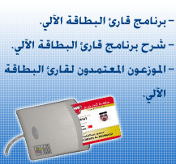
Plans To improve the civil Registration and Vital Statistics -2
Central Informatics Organization – Civil Population Registration
Issuing of Smart Card is an electronic card with
the capability of securely storing a variety of information
about the holder. For every citizen and resident in the Kingdom of Bahrain
The Smart Card contains data and information from the holder's passport, ID card,
CPR card, driving license, basic medical details and the latest academic
qualifications.
It combines three current cards into one. (The immigration ID card issue by the General Directorate for Passports, Nationality and Residence (GDNPR), the driving license issued by the General Directorate for Traffic (GDT) ,and the Central Population Registry (CPR) card issued by the CIO.
As well as a health card, an election card, a labour card, an electronic payment card (e-Purse) and a travel document to allow cardholder to pass through the electronic border control gates at the border crossing points such as the airport.

Slide 15



DISCUSSION

